Slide 1
BAEA bi-annual conference, Dhaka
22-23 Jan 2016
CONVERGENCE OF POLICIES AND PROGRAMS FOR
SUSTAINABLE AND CLIMATE RESILIENT AGRICULTURE
Dr. Zahurul Karim
Dr. A.K. Enamul Haque

Slide 2
1.
The potential impact of climate change is going to be much greater on Bangladesh from 2030 and onwards than what it has been observed or experienced today.
Climate Change has been one of the major threats to Bangladesh economy

Slide 3
2.
Hertel, Burke and Lobell in their research predicted that Bangladesh would experience a net increase in poverty by 15% by 2030 while food exporting countries like the Philippines and Thailand would benefit from food price rises due the climate change
3.
IPCC AR5 documents produced by the Working Group II also predicted that coastal area of Bangladesh and the rice agriculture in both the floodplains and in coastal deltaic regions will be affected.

Slide 4
IPCC AR5
Sea-level rise threatens coastal and deltaic rice production areas in Asia, such as those in Bangladesh …

Slide 5
HELLO!
Climate Change is Real
It requires action and understanding of the consequences of CC on our agriculture.
There is a need for realigning policies and programs of agriculture in Bangladesh.

Slide 6
Overview of our Agriculture
  Agriculture contributes to 19% of GDP
  42% of Employment
  9% of our Export
  Its plays in important role for ensuring
  Food security
  Nutrition security
  Sustainability

Slide 7
Crop and Horticulture contributes to 9% of GDP
Rice is 80% of land under crop agriculture
        Boro contributes to 60% of Total Rice
        Long term growth in rice is 2.8%
      Agriculture is changing too
      Aus Area falling
      Aman area falling
      Boro rising
      Vegetable rising
      Potato rising
  AGRICULTURE IS BECOMING CAPITAL INTENSIVE
  Bulls being replaced by tractors
  Men being replaced by women
  Non crop agriculture rising – fish, poultry, dairy, meat etc.

Slide 8
ON THE DEMAND SIDE
RICE CONSUMPTION FALLING
WHEAT CONSUMPTION RISING
MEAT CONSUMPTION RISING
MILK AND EGG CONSUMPTION RISING

Slide 9
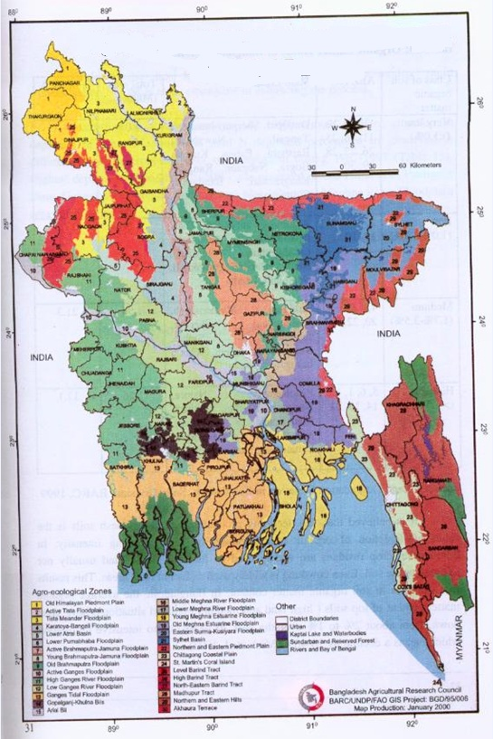
AGRO-ECOLOGICAL ZONES
OF BANGLADESH

Slide 10
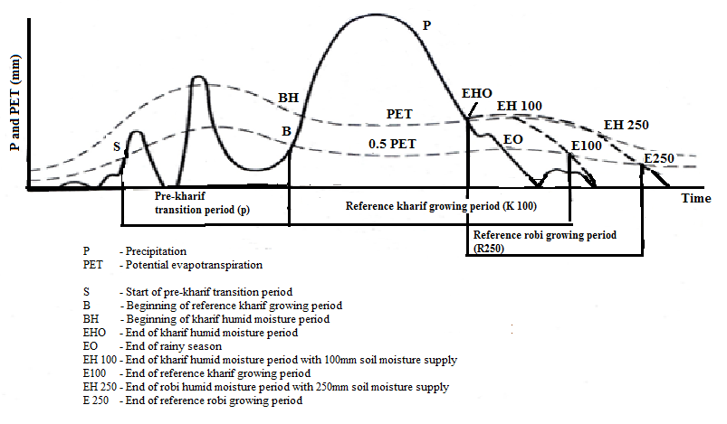
AGRICULTURE AND RAIN

Slide 11
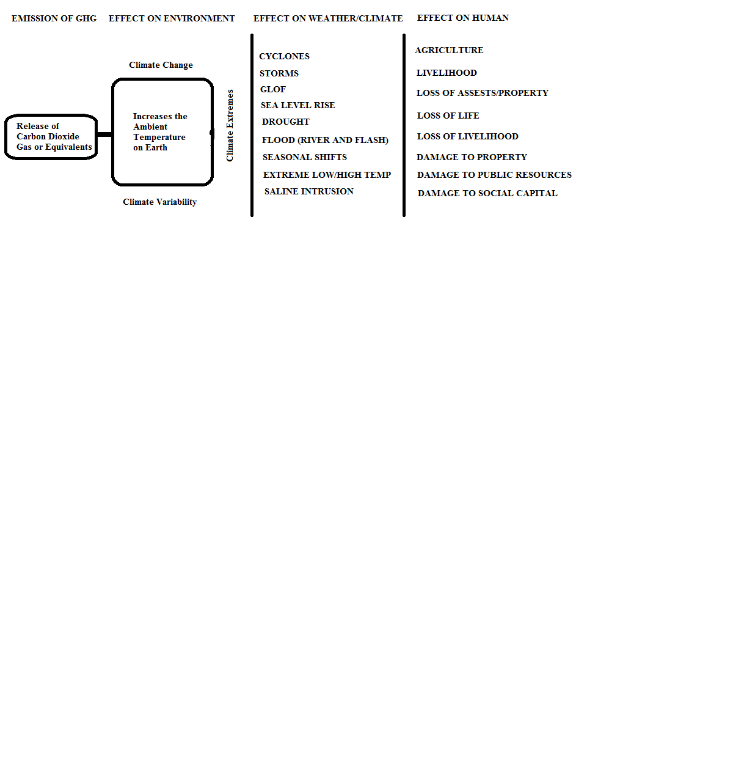
Climate Change is a change in the long term pattern of the weather and hence it is often difficult to ascertain from layman’s eye.

Slide 12
World Bank 2013 study
The report cited Bangladesh as one of more “potential impact hotspots” threatened by “extreme river floods, more intense tropical cyclones, rising sea levels and very high temperatures”. A potential 10 year return cyclone in 2050 could expose 9.7 million people to more than 3 meters of inundation affecting agriculture and lives

Slide 13
RISKS TO OUR AGRICULTURE DUE TO CLIMATE CHANGE
Crop fields in the floodplains of Bangladesh (nearly 70% of total agricultural land) faces the risk of frequent flooding due to erratic pattern of precipitation in the catchment areas of the rivers
Aman rice season which supplies nearly 40% of the total rice production in Bangladesh faces the risk of crop failures due to extreme or untimely rain and/or dry spells
Crop and horticulture production is extremely sensitive to temperature during the flowering periods.
prolong periods of low temperature and this would make the agriculture susceptible for crop failures. This is true for both amon and boro rice as well as for many horticultural products like winter vegetables and fruits.

Slide 14
RISKS TO OUR AGRICULTURE DUE TO CLIMATE CHANGE
Saline water intrusion in coastal crop lands making the crop and horticultural production at risk due to higher salinity in soil and in water.
Southern agricultural lands in Bangladesh will be facing shortage of sweet water for irrigation during boro season and so investments in polders to recover coastal floodplains for agricultural production are at risk. Most of the reclaimed or protected coastal agricultural land will face severe sweet water shortage during winter months
Coastal agricultural lands during monsoon and late monsoon months (July – November) will be suffering for the risk of breach of polders and embankments due to increased incidences of storms and cyclones.
Pattern of rainfall is also predicted to become erratic in the short run and this will create a problem for aman rice production. Aman rice may require supplementary irrigation for which agricultural irrigation system is not fully prepared.

Slide 15
RISKS TO OUR AGRICULTURE DUE TO CLIMATE CHANGE
Prolonged and frequent episodes of climate variability and climate extreme events (including saline water intrusion and drought) will force rural people to migrate outside and probably to urban locations
This will create critical shortage of labor for agriculture and so the existing agricultural practices will be at risk.
Polders are designed with sluice gates which exploit the natural tidal cycles to drain excess water out of agricultural land during rainy seasons. Sea level rise (SLR) will reduce the capacity of the sluices to drain excess water out of crop lands and so it might lead to prolonged water-logging in rainy seasons.
Changes in precipitation in the GBM basins (including areas in the Himalayas) might bring the pre-monsoon floods earlier than expected or it might delay it (both of these situations are possible). The erratic nature of flooding will create significant uncertainties will increase risks of rice production in these regions.

Slide 16
RISKS TO OUR AGRICULTURE DUE TO CLIMATE CHANGE
sugarcane, jute, potato, winter vegetables and fruits will also be facing risks of production failure due to climate change. climate variability and extreme events.
Increase in the day temperature and decrease in the winter precipitation will severely reduce moisture content in the soil leading to severe moisture stress in the topsoil. …December would severely retard wheat and boro crops both in terms of germination and vegetative growth
  ON LIVESTOCK AND POULTRY
  Increased precipitation in many parts of Bangladesh will create shortage of food for livestock and so livestock farmers will face increased risks.
  Increased rainfall or increase in the number of rainy days will increase the risk of diseases for their livestock, in particular for cattle and goat farmers.

Slide 17
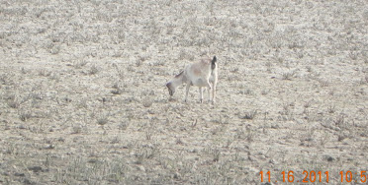
RISKS TO OUR AGRICULTURE DUE TO CLIMATE CHANGE
Frequent flooding and shortage of feed supply in the floodplains will increase the price of feed and will force many farmers (particularly marginal households who are likely to stay at flood-shelters during episodes of flooding) to sell their animals
Livestock farmers in the coastal belts will face increased threat of feed shortages due to saline water intrusion in their lands.
both coastal and drought regions of Bangladesh will be facing a new challenge in terms of livestock farming.
Flood and cyclone hit regions of Bangladesh are equipped with shelters to protect human life and properties. However, animals are left at the mercy of the nature to survive through the events.

Slide 18
RISKS TO OUR AGRICULTURE DUE TO CLIMATE CHANGE
Both extreme low or high temperature are responsible for diseases in animals. As climate change, climate variability and climate extreme events are likely to generate spells of colder days and hotter days, the risk of diseases in animal farming (both for poultry and livestock) increases.
On Fisheries
Flood and tidal surges are responsible for washing away culture fish into the rivers and lakes
Hot weather spells in winters might dry-up the rivers and lakes causing the mother fisheries to either die due to shortage of water or of dissolved oxygen level in water or being caught by people.

Slide 19
RISKS TO OUR AGRICULTURE DUE TO CLIMATE CHANGE
increased evapo-transportation might also fragment the river into pieces of stagnant water bodies in the dry season. This will lead to closure of migration routes and hence mother fisheries fail to reach their spawning ground during the early months of rainy season (the spawning season of fresh water fishes).
Fisher communities engaged in capture fishing from large rivers and from coastal or marine areas are likely to be affected due to frequent cyclone or storm warnings.
Increased salinity in water due to sea level rise will affect the spawning ground for fishes in the mangrove areas and so total stock of fish population will be reduced.

Slide 20

NEED POLICY CONVERGENCES
DEVELOP COHERENT POLICIES
ON FOOD AND NUTRITION SECURITY BASED ON ANALYSIS OF
FUTURE RISKS ON
AGRICULTURAL PRODUCTION
INVESTMENT IN AGRICULTURE
SUPPLY CHAINS IN AGRICULTURE

Slide 21

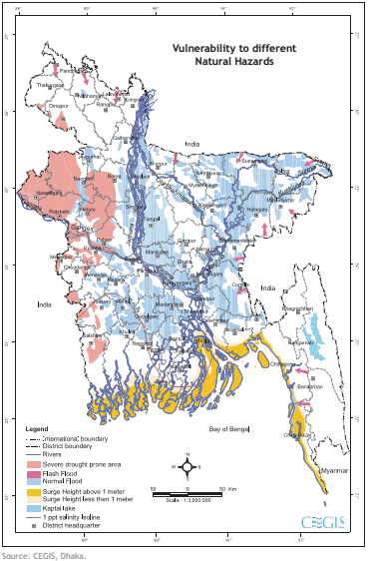
VULNERABILITY BY DISASTERS
FLOODS
DROUGHTS
SALINE INTRUSION

Slide 22
CLIMATE CHANGE REVISITED
ttp://slidemodel.com
EXTREME
EVENTS
SLOW ONSET EVENTS
CLIMATE EVENTS
CLIMATE VARIABILITY

Slide 23
WHAT NEEDS TO DONE
AWARENESS
EDUCATION
SKILLS
VARIETIES
CROP CHOICE
PRODUCTION TECHNOLOGY
COMMERCIALIZATION
FINANCING MECHANISM
REORGANIZATION OF AGRICULTUREAL SUPPORT SERVICES
ADAPTTION
RESHAPE
AGRICULTURAL INSTITUTIONS,
AGRICULTURAL RESEARCH,
INNOVATE

Slide 24
STRATEGIES FOR REDUCING VULNERABILITY
SLOW ONSET DISASTERS
Monitor Slow Onset Disaster events, measure loss and damage, and provide support
Support for saline zone farmers – new variety, new crops, new system of agriculture
Support for drought zone farmers – new crops, input support,
Crop switch / crop rotations.
Smart agricultural practices for quick recovery

Slide 25
STRATEGIES FOR REDUCING VULNERABILITY
TO CLIMATE EXTREMES
EARLY WARNING SYSTEM FOR AGRICULTURE
IMPROVEMENT OF SHORT TERM FORECASTS TO PROTECT FARMERS
    3 DAYS FORECASTS TO 15 DAYS FORECASTS
SUPPLY OF AGRICULTURAL INPUTS
QUALITY OF EXTENSION SERVICES – RICE TO NON-RICE
PROTECTION FOR DOMESTIC ANIMALS DURING DISASTERS
FLOOD CONTROL AND DRAINAGE INFRASTRUCTURE IMPROVEMENT
SUPPLEMENTARY IRRIGATION FACILITIES
RESEARCH AND INNOVATION
CULTURE FISHING
FEED BUFFER STOCKS
Pest Management infrastructure

Slide 26
STRATEGIES FOR REDUCING VULNERABILITY
TO CLIMATE LONG HORIZON EVENTS
Adjusting flood control infrastructure against SLR
Adjusting irrigation infrastructure
Education and training
Facilitating migration
Promoting alternative livelihood strategies
Research and Innovation
Institutional changes to coordinate post-disaster programs
Promoting access to finance through commodity exchange and insurance markets
Combining mitigation with adaptation

Slide 27
GENERAL MEASURES FOR BUILDING RESILIENCE
Varietal Development
Management practices to deal with water and saline stresses
Agricultural input supplies
Quick remedial crops
Water conservation practices
Deep tillage and sowing techniques
Crop calendar adjustment
Tidal zone agricultural practices
Agricultural practices in water-logged areas
Post disaster support policy
Risk sharing with non-agricultural agents using commodity market and
Develop financing mechanism and insurance

Slide 28
Adaptation PLUS program (with mitigation)
Water conservation practices drip, sprinkler, AWD techniques
Establish a High Powered Commission on Agriculture to Develop a NEW STRATEGY FOR AGRICULTURE KEEPING IN VIEW
CLIMATE CHANGE, FOOD AND NUTRITION SECURITY.

